Slide 1

While we wait, access the slides and exercises at : And add a couple songs to the playlist! ☺
github.com/conkline/DataSkillsWorkshop2024
https://open.spotify.com/playlist/5gZHBE0vh4oOkffmON9PNl
Data Skills for Biology Workshop 2024

Slide 2
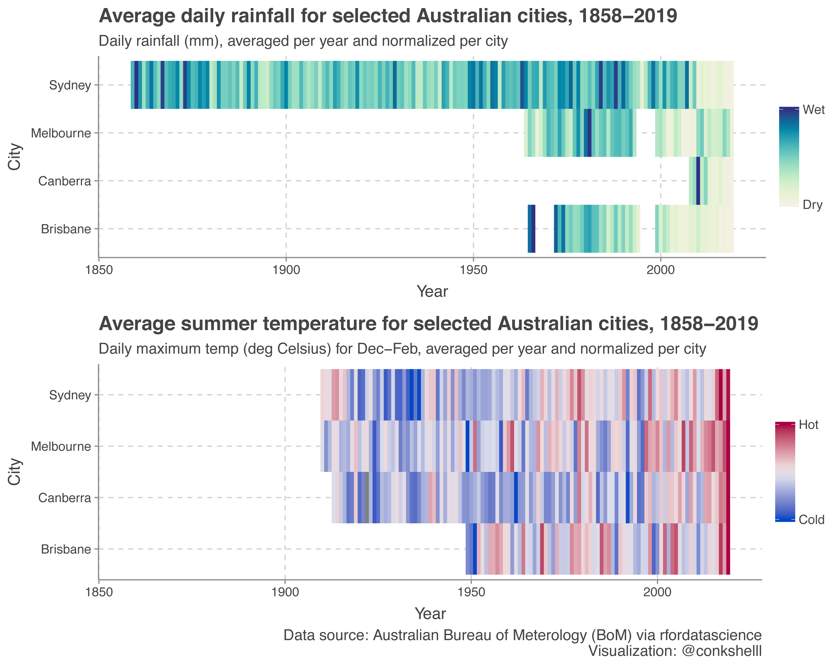
Advanced DATA Visualization
Emily Conklin (she/they)
Data Skills for Biology Workshop, May 2024

Slide 3
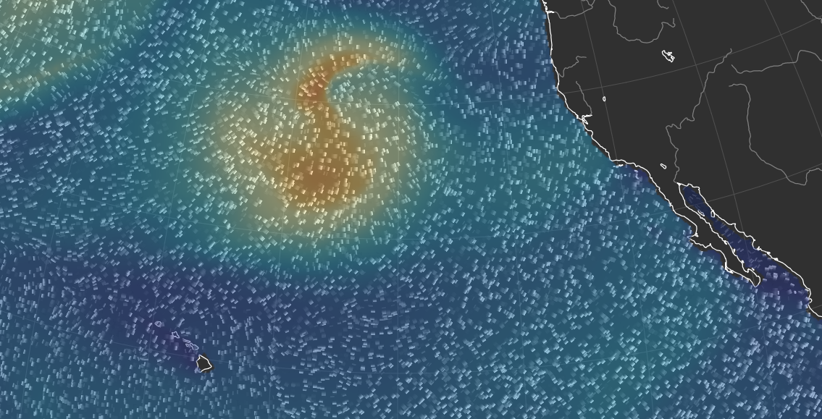
What makes good (biological) visualization?
Effective – easily interpreted by users
Accurate - sufficient for correct quantitative evaluation
Efficient - quick and scientific understanding of biological data
Aesthetics - must not offend users’ senses
Adaptable - could be used in different occasions and different disciplines.
Ren et al. 2012

Slide 4
Why R?

Slide 5
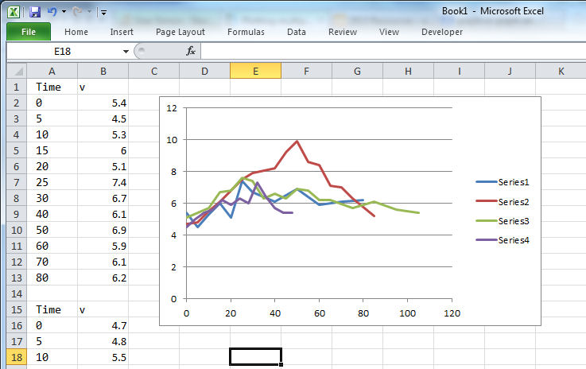
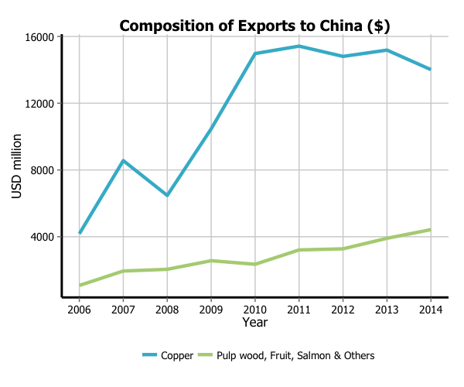
R vs. Excel
Can handle very large datasets (millions of rows / columns)
Much faster
Easier to automate
Reproducible
Open source and free
Much easier to make complex/advanced plots
http://t-redactyl.io

Slide 6
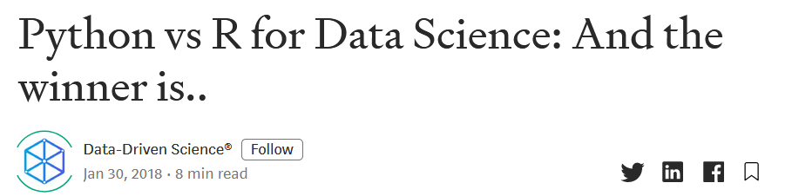
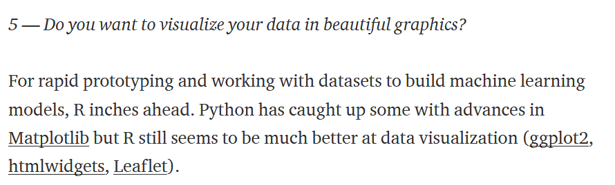
R vs. Python

Slide 7
base-R For data exploration

Slide 8

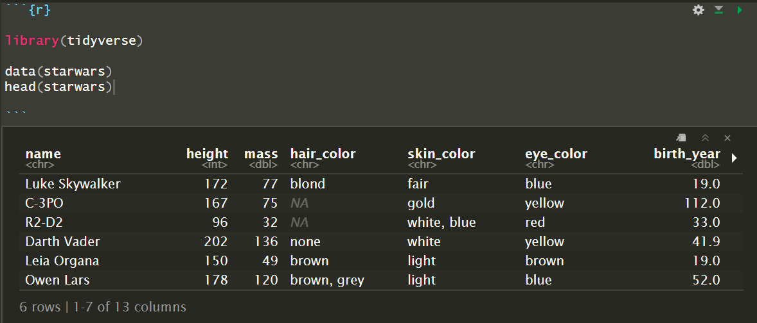
Base R: Built-in functions for plotting
Quick ways to explore our dataset?

Slide 9
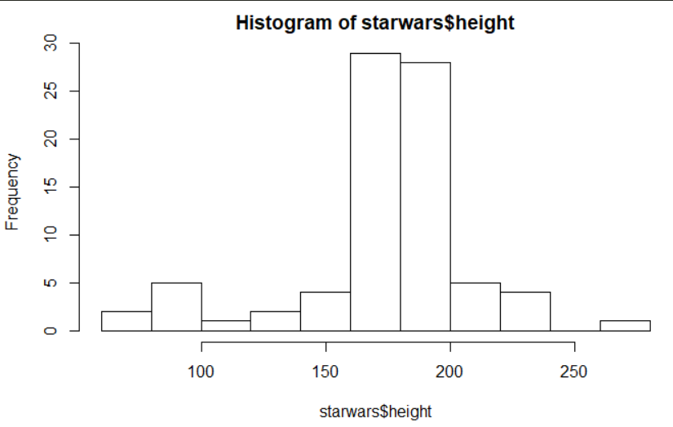
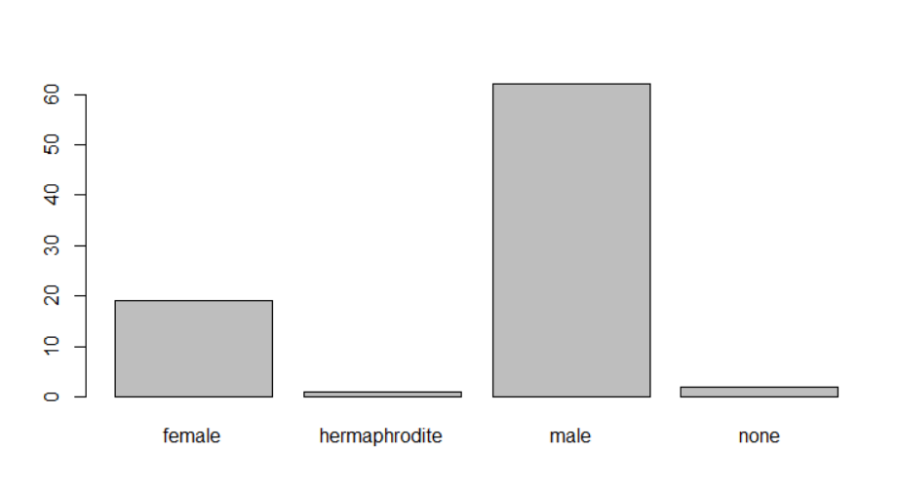
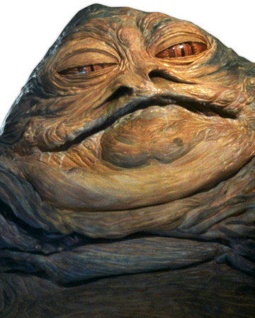
Checking out data with hist() and barplot()
hist(starwars$height)
barplot(table(starwars$gender))

Slide 10
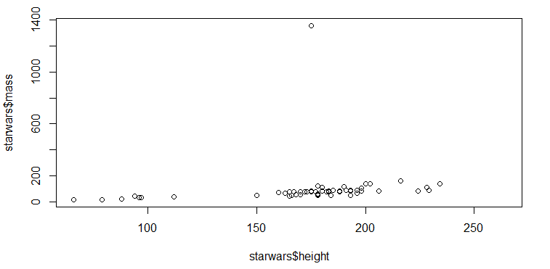
A quick look at relationships between variables
plot(starwars$height, starwars$mass)

Slide 11
Exercise #1: Plotting in base R
Open up the file:
01exercise_workshop_data-visualization.Rmd
and give Exercise #1 a try.
Use one (or more) of the following base R functions:
plot()
hist()
pie()
barplot()
boxplot()

Slide 12
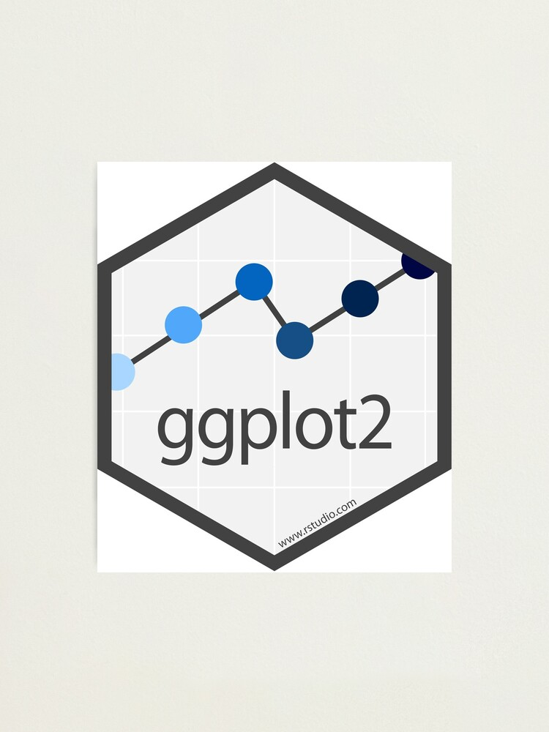
Why bother learning base R?
It’s much easier to make complex plots in ggplot2
BUT
Many discipline-specific R packages are built around base R

Slide 13
Getting fancy with ggplot2

Slide 14
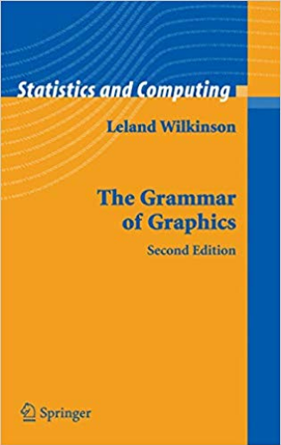
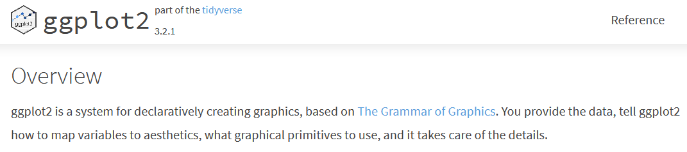
What is ggplot2?
https://ggplot2.tidyverse.org/

Slide 15
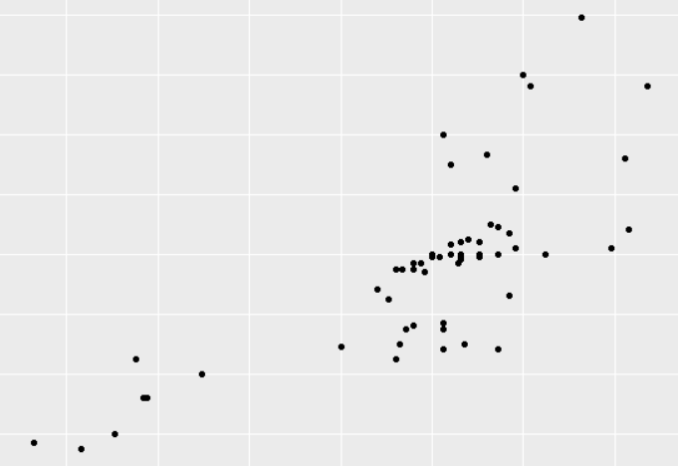
ggplot objects consist of a few parts
ggplot(data = starwars) +
geom_point(mapping = stuff)
y = mass
x = height

Slide 16
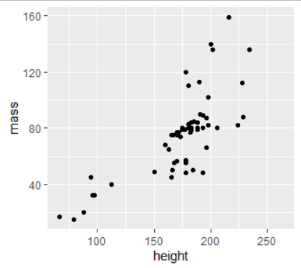
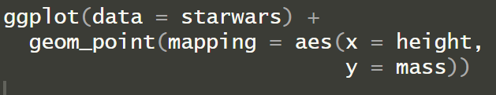
And the actual code:
Using the data starwars, which contains variables:
height
mass
starship
etc.
y = mass
We can map this data to different aesthetics (aes) in the plot:
x
y
size
color
fill
alpha
x = height

Slide 17
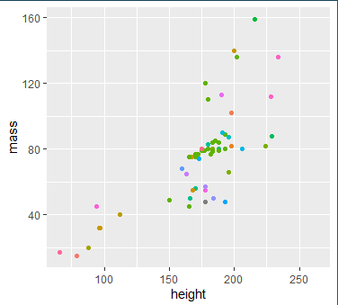
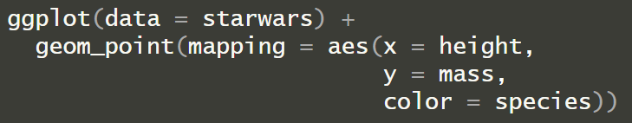
Adding another aesthetic mapping

Slide 18
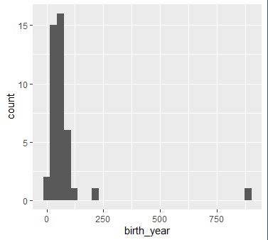
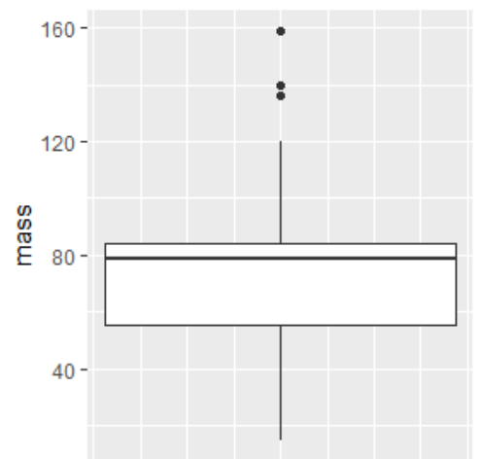
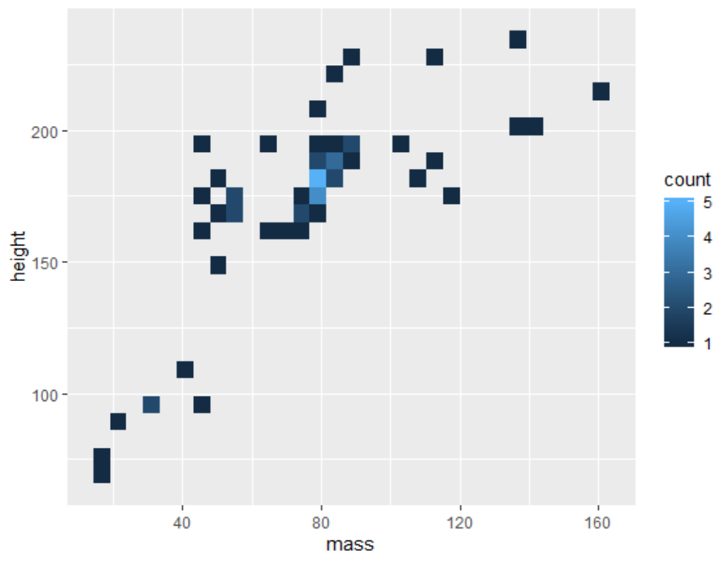
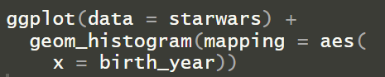
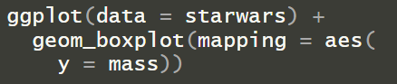
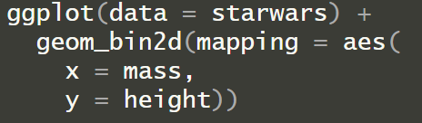
Trying out different geom functions
Changing the geom_* function

Slide 19
Trying out different geom functions
Changing the mapping aes()

Slide 20
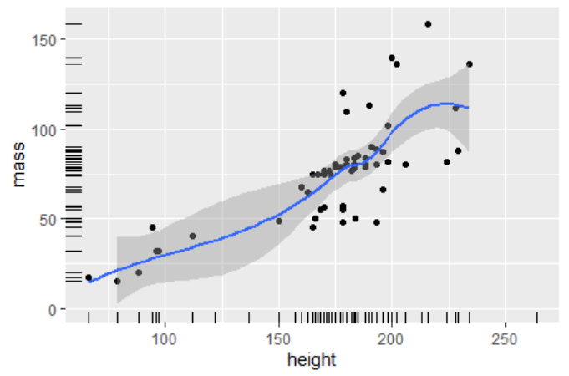
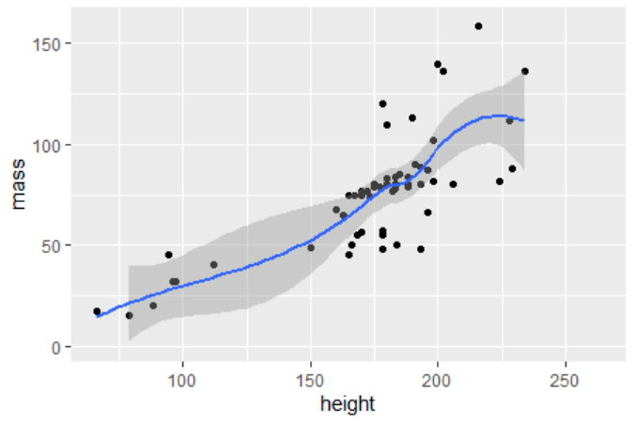
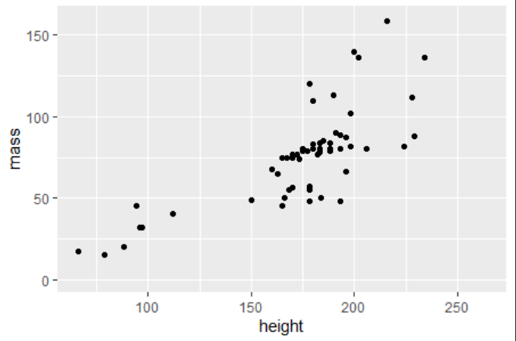
ggplot2 works in layers
ggplot(data = starwars) +
geom_point(mapping = stuff) +
geom_smooth(mapping = stuff) +
geom_rug(mapping = stuff)

Slide 21
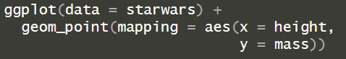
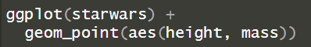
One note about format
Named
variables
will do the same thing as:
ggplot2 functions are smart about input order – to a point
Unnamed
variables

Slide 22
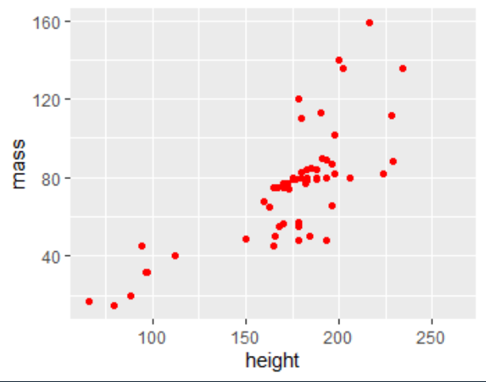
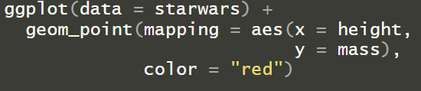
Mapping vs. basic parameters

Slide 23
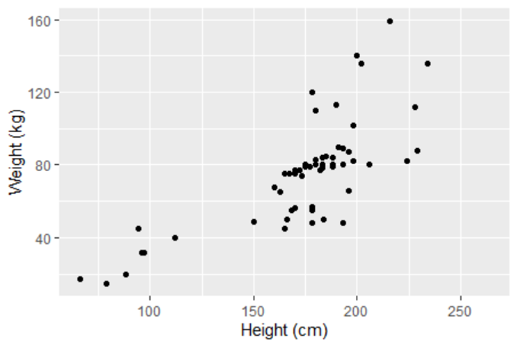
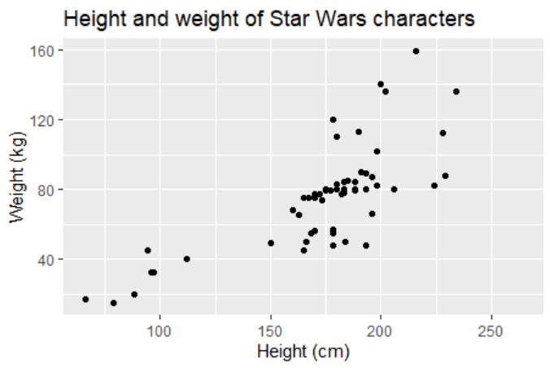
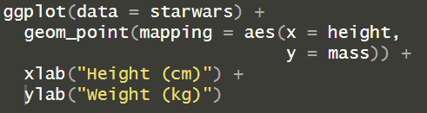
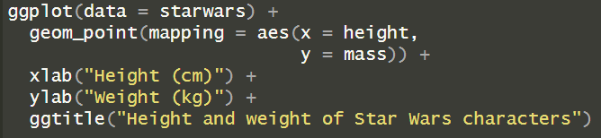
Customizing ggplots – adding labels and title

Slide 24
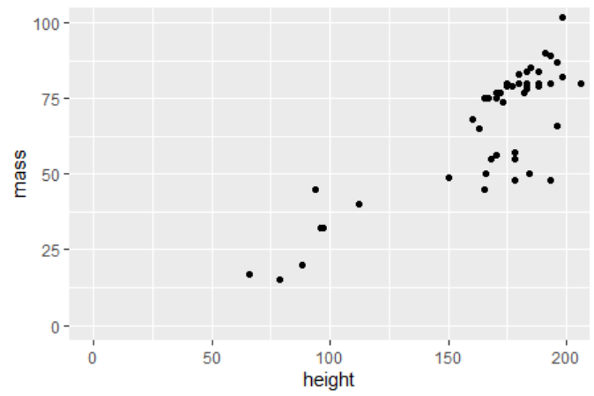
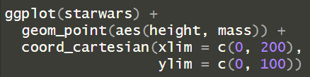
Customizing ggplots – adjusting axes

Slide 25
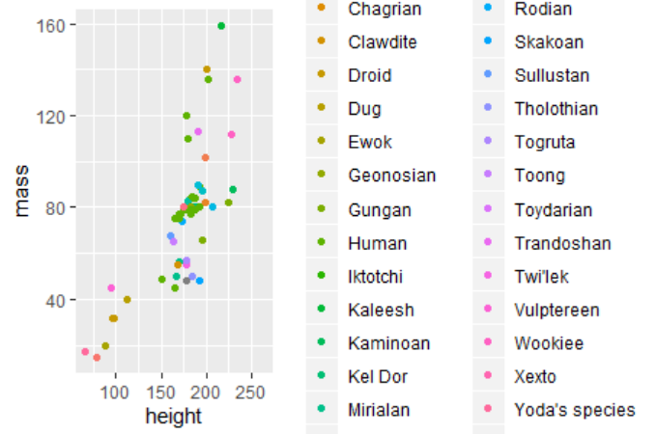
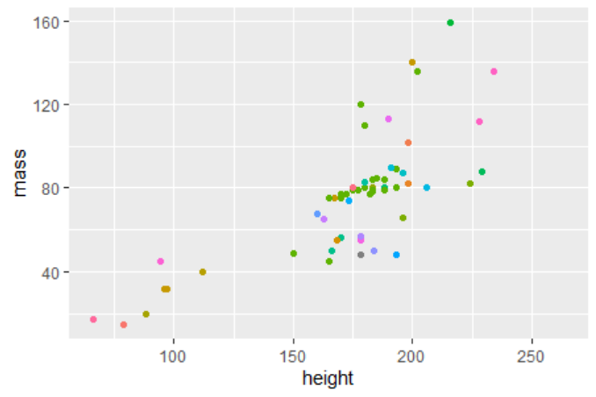
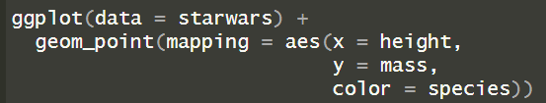
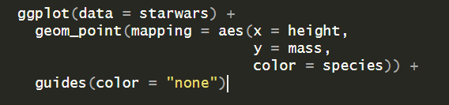
Customizing ggplots – clearing clutter

Slide 26
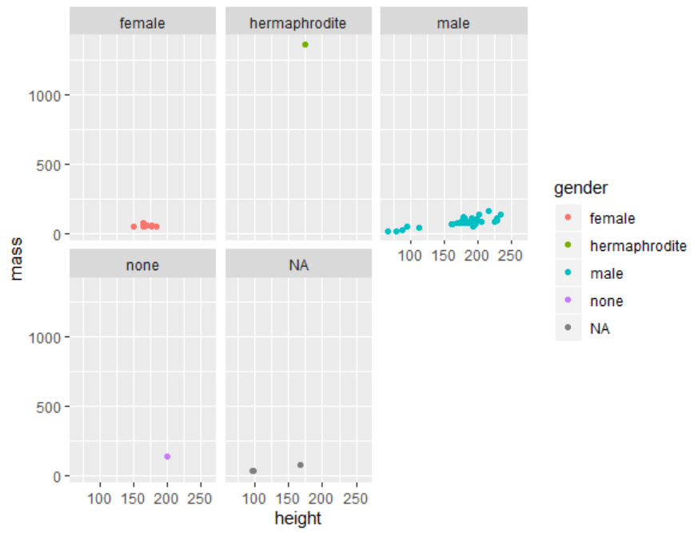
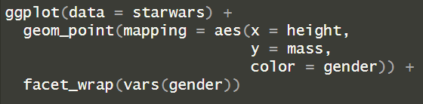
Faceting – grouping your data by variable

Slide 27
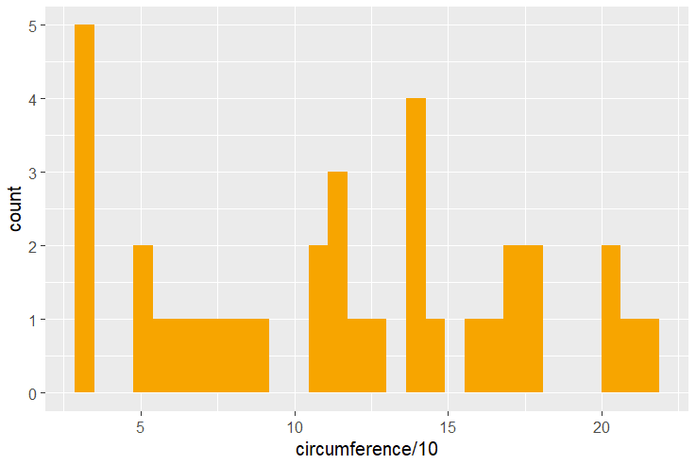
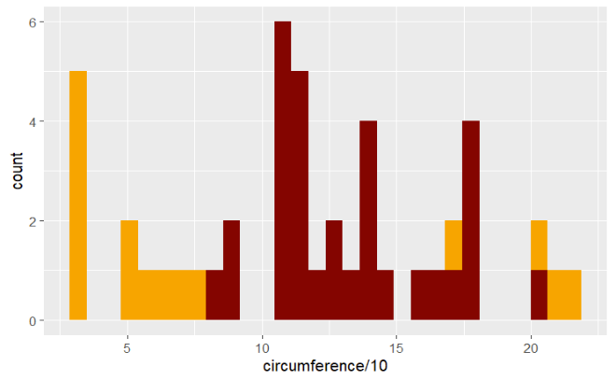
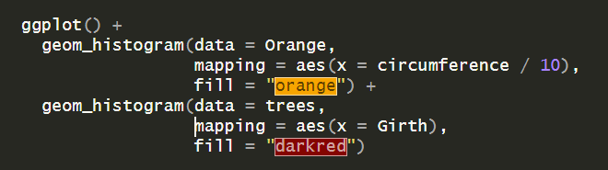
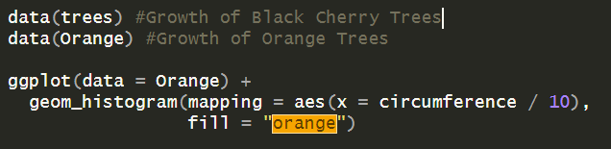
Plotting with multiple datasets

Slide 28
Exercise #2: Basic plots in ggplot2
In your RMarkdown file, try out Exercise #2: plotting, changing geom functions, and changing mapping aesthetics in ggplot2!

Slide 29
Un-DEFAULTING your ggplots

Slide 30
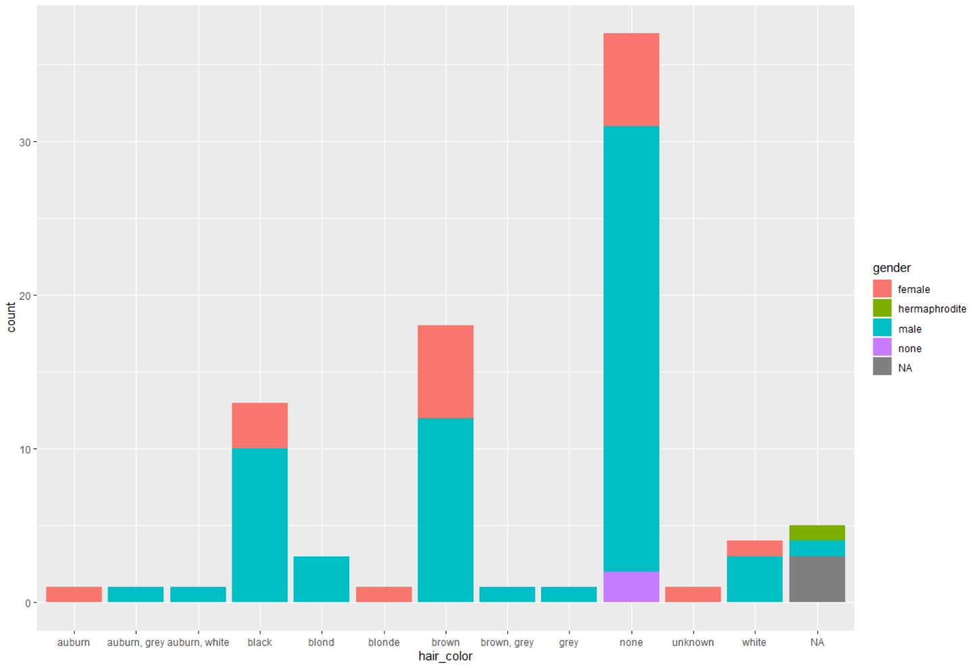
ggplot2 is awesome, but…
How do I un-default my plots?
Change the theme
Change the color palette
Change the font

Slide 31
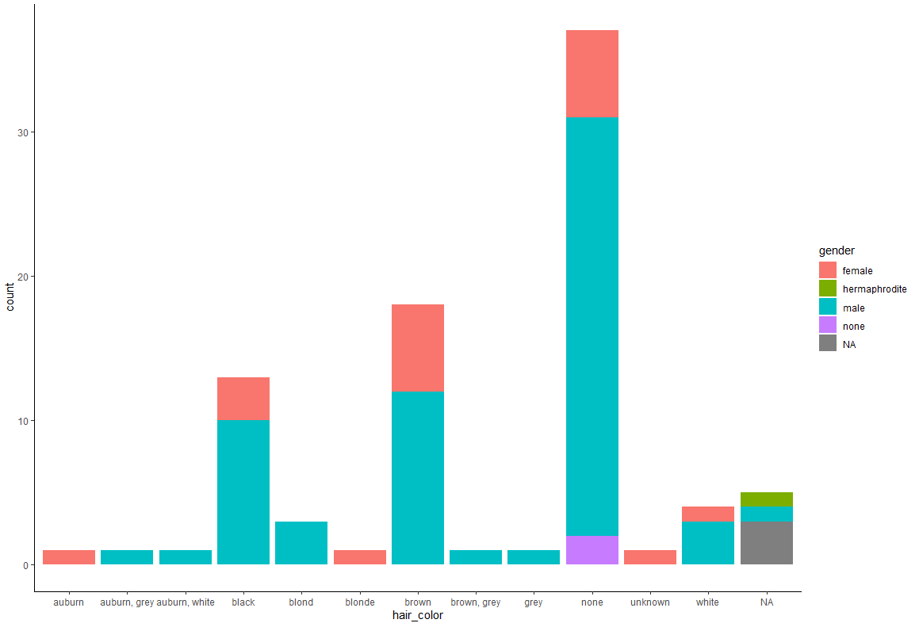


Built-in themes can make a big difference
+ theme_classic()
+ theme_minimal()
+ theme_dark()
ggplot(starwars) + geom_bar(aes(x = hair_color, fill = gender))

Slide 32

Customization with the + theme()
How do I...
Change the font?
Change the background color?
Space my tick marks differently?
Rotate my axis labels?
Change how the legend looks?
Etc...
theme()

Slide 33

Changing the font with theme()
+ theme(text=element_text(size=16, family="Comic Sans MS"))

Slide 34


Switching up the color palette
scale_fill_manual(values = c("red", "darkred", "purple", "cyan"))

Slide 35

Watch out for color vs. fill…
scale_fill_manual(values = c("red", "darkred", "purple", "cyan"))
scale_color_manual(values = c("red", "darkred", "purple", "cyan"))
Fill = bars, tiles, shapes, etc.
Color = lines, points, outlines, etc.

Slide 36
Un-GGPLOTTING your ggplots

Slide 37

When we need to get ungrammatical

Slide 38



A few useful ggplot extensions
ggthemes, ggthemr,
hrbrthemes
Many additional themes
ggnewscale
Multiple color scales per plot
ggrepel
Non-overlapping labels
https://yutannihilation.github.io/allYourFigureAreBelongToUs/ggthemes/
https://github.com/Mikata-Project/ggthemr
https://github.com/hrbrmstr/hrbrthemes
https://eliocamp.github.io/ggnewscale/
https://cran.r-project.org/web/packages/ggrepel/vignettes/ggrepel.html

Slide 39
See also...
ggblanket/ggcharts/ggpubr: Simplify ggplot plotting
gghighlight: Easily highlight a category/observation
ggtree/ggdendro: Phylogenetic trees and dendrograms
ggraph: Visualize networks
ggridges: Ridge plots
gganimate: Animated plots
ggiraph/plotly: Interactive plots
...and more!

Slide 40



Bored of ggplot’s built-in color schemes?
Lots of color scheme packages – I like colorspace
choose_palette() opens up color GUI
Notes:
Demo

Slide 41








Built-in accessibility functions
deutan()
protan()
tritan()

Slide 42


Assembling plots with patchwork
A great tool for sticking plots together, adding insets and labels, and more!
@cj_battey

Slide 43


Assembling plots with patchwork
Use + to add multiple plots together
Want a different number of rows/columns? Use:
p1 + p2 + plot_layout(ncol = 2)
p1 + p2 + plot_layout(nrow = 2)

Slide 44


Assembling plots with patchwork
Use | for columns
Use / for rows

Slide 45

Adding an inset plot

Slide 46


Adding annotations and style

Slide 47
Adding annotations and style

Slide 48

Adding annotations and style

Slide 49
Adding annotations and style

Slide 50


Adding annotations and style
For more functionality, check out the tutorials at:
https://patchwork.data-imaginist.com/articles/patchwork.html
https://patchwork.data-imaginist.com/articles/

Slide 51
Data wrangling for plotting

Slide 52

Help, my data is a mess!
Often, most of the labor in making a figure happens way before we get to ggplot
https://handsondataviz.org/clean.html
“Tidy” data needs three things: 1) One variable per column
2) One observation per row
3) One value per cell

Slide 53

Pivoting data – “wide” to “long”
Sample dataset – survey data with religion and income
Tricky to plot in this format

Slide 54

Pivoting data – “wide” to “long”
Reshape every column except for ‘religion’
Gives the name of the new variable made from the data in the column names
Gives the name of the new variable made from the data in the cells

Slide 55

Pivoting data – “wide” to “long”
And now we have something plottable!

Slide 56



Adding new variables
Pipe function: chains commands together
Same as %>%
Black Cherry Tree growth

Slide 57



Summarizing variables by group
Orange Tree growth

Slide 58


Filtering data
Orange Tree growth

Slide 59




Arranging data

Slide 60




Merging datasets
Keeps all observations in dataset ‘x’, merges with dataset ‘y’
See also:
right_join()
inner_join()
outer_join()

Slide 61
Flexing your data viz muscles

Slide 62

Practice makes perfect – don’t wait until you’re writing the paper!
https://github.com/rfordatascience/tidytuesday

Slide 63


Figure recreations are another great way to practice R data visualization
geom_facet?
ggmap?
stat_density2d?
geom_tile?

Slide 64

Bonus side effect: Greater appreciation for reproducible data and code
yerun.eu

Slide 65
Further reading/exercises:
https://djnavarro.github.io/robust-tools/visualisation/#1
https://r4ds.hadley.nz/data-visualize
https://uoftcoders.github.io/rcourse/lec04-dplyr.html
https://bookdown.org/max_ricciardelli/wrangling_modules/data.html#cleaning_data
http://colorspace.r-forge.r-project.org/articles/color_vision_deficiency.html
https://github.com/erikgahner/awesome-ggplot2

Slide 66
Free work time!
Ask questions
Work on exercises #3 & #4
Work on visualizations using your own data
Check out some of the packages linked in the slides
Find a fun dataset at https://github.com/rfordatascience/tidytuesday
Take off if you need to!
MANDATORY: Add some songs to the playlist ☺
https://open.spotify.com/playlist/5gZHBE0vh4oOkffmON9PNl

